Slide 1
The Value of Home Health for
Individuals Living with Heart Failure:
A Systematic Review
Diana Mikula SPT
Nicole Nemeth SPT
Kierstyn Pieroni SPT
Marley Szczesniak SPT
Dr. Tracey Collins PT, PhD, MBA, Board-Certified Clinical Specialist in Geriatric Physical Therapy
Notes:
Diana

Slide 2
Overview
Results
Conclusion
Limitations
Recommendations
Clinical Relevance
Background
Purpose
Methods
PRISMA
PEDro Scoring
Notes:
Diana

Slide 3
Background
Heart failure is the end stage of heart disease characterized by periods of clinical stability and instability¹
Results in decreased quality of life (QOL)¹
Number one cause of hospital readmissions across the country²
Inadequate evidence exists for best practice following hospital discharge²
Home health has been found to improve physical, psychological, and environmental domains of QOL³
Notes:
Diana

Slide 4
Value
Value is defined as cost- effectiveness, hospital readmission, patient experience, and quality of life⁴
Notes:
Diana

Slide 5
Importance of Value
Triple Aim defined by the Institute for Healthcare Improvement⁵
Improve population health⁵
Reduce healthcare costs⁵
Improve patient experience⁵
Current system focused on financially incentivized market⁵
Healthcare decisions and delivery based on monetary gains by insurance companies and providers⁵
New healthcare reforms move toward alternative value-based payment models in continuum of care⁵
PDGM beginning January 1st, 2020⁶
Notes:
Patient driven grouping model

Slide 6
Purpose
To determine the value of home health compared to other post-acute settings for individuals living with heart failure
Notes:
Diana
The purpose of this study was to determine the value of home health compared to other post-acute settings for individuals living with heart failure.

Slide 7
Methods
Notes:
Marley

Slide 8
Databases Searched
ProQuest
Health Source
JAMA
CINHAL
Medline
Notes:
Marley

Slide 9
Search Terms
(“Heart failure” OR “congestive heart failure” OR CHF)
AND
(“Home health” OR “home care” OR “home-based rehab”)
AND
(physical therapy OR physiotherapy OR rehabilitation)
AND
(value OR “patient experience” OR “patient satisfaction” OR “quality of life”)
Notes:
Marley

Slide 10
Search Limits
Peer-reviewed RCTs
English
Human subjects
Published between 2009 and 2019
Notes:
Marley

Slide 11
Selection Criteria
Adults with a diagnosis of heart failure
Receiving home health care or other post-acute care
Included selected outcomes to assess value
Notes:
Marley

Slide 12
Exclusion Criteria
If patient had comorbidities of:
Diabetes
COPD
Hospice Care
Notes:
Marley

Slide 13
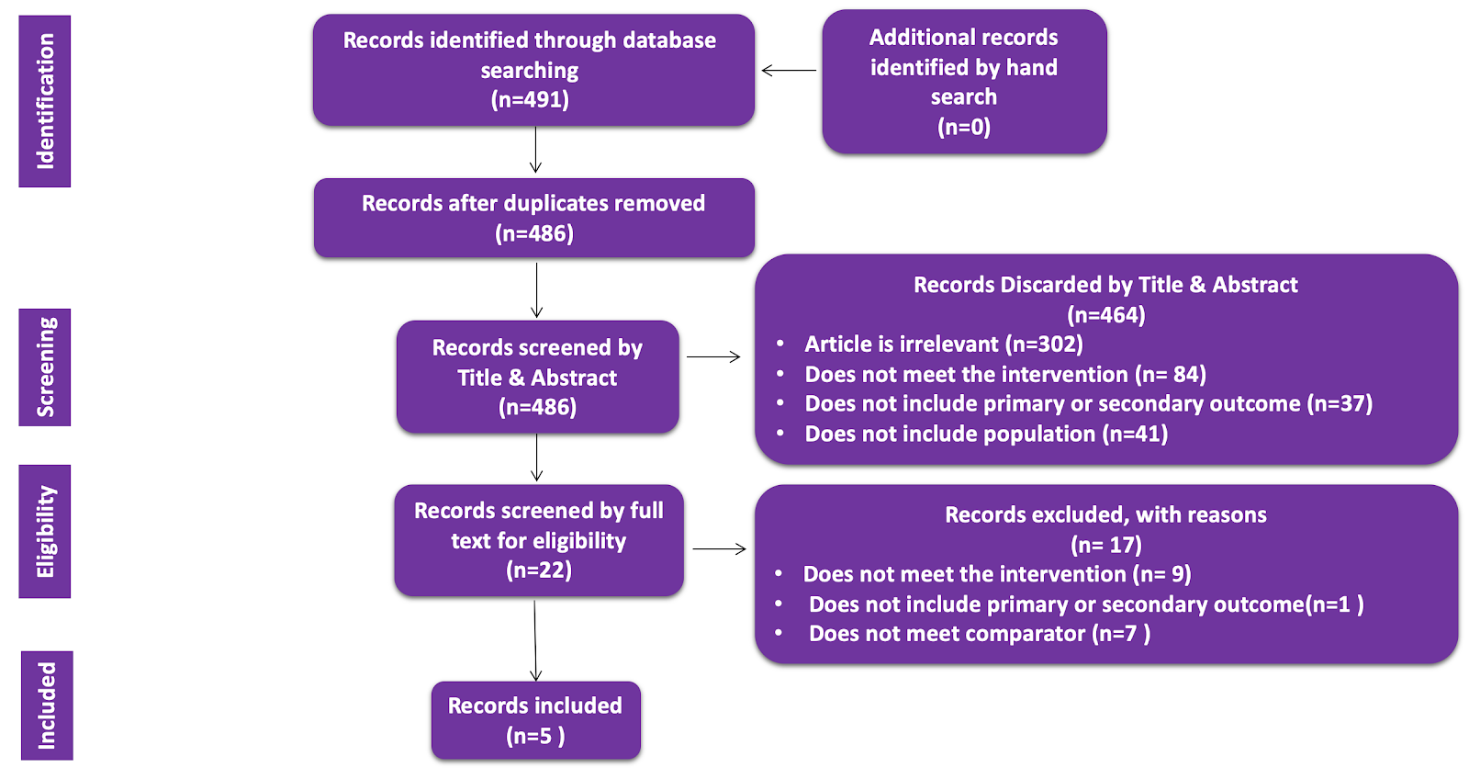
PRISMA
Notes:
Marley

Slide 14
5 Randomized Control Trials
PEDro Scores | 1 | 2 | 3 | 4 | 5 | 6 | 7 | 8 | 9 | 10 | 11 | Score
Tibaldi et al⁷ | Y | Y | Y | Y | Y | N | N | N | Y | Y | Y | 7/10
Brännström et al⁸ | Y | Y | Y | Y | N | N | N | Y | Y | Y | Y | 7/10
Sahlen⁹ | Y | Y | Y | Y | N | N | N | Y | Y | Y | Y | 7/10
Stewart¹⁰ | Y | Y | Y | Y | N | N | N | Y | Y | Y | Y | 7/10
Levine et al¹¹ | Y | Y | Y | Y | N | N | N | Y | Y | Y | Y | 7/10
Notes:
Marley
EDIT CITATIONS 8-12 instead of 6-10

Slide 15
Results
Five RCTs fulfilled the criteria
PEDro scores ranged from 7/10
Samples ranged from 21 to 280 subjects (546 total) with heart failure (NYHA class 2-4)
Home care sessions ranged from 6-18 months, with unspecified visits per week
All five studies included multidisciplinary care (PT, OT, Physician, Nursing)

Slide 16
Results (continued)
Primary Outcomes:
Secondary Outcomes:
To assess value included:
Cost effectiveness
Hospital readmission
Patient experience
Quality of life

Slide 17
Results: Cost of Care
Article | Home Health | Comparator
Tibaldi⁷ | $158.73 per day | $401.37 per day (inpatient hospital)
Sahlen⁹ | €140,000 | €205,000 (control group)
Levine et al¹¹ | 52% lower than control group – no dollar amount given
Stewart¹⁰ | $34 AUD per day | $52 AUD per day (clinic based)

Slide 18
Results: Hospital Readmission
Article | Home Health | Comparator | p-value
Brännström et al⁸ | 15 rehospitalizations in 103 days | 53 rehospitalizations in 305 days (usual care) | Not reported
Tibaldi et al⁷ | 84 days to hospital readmission | 69 days to hospital readmission (inpatient) | P = 0.02
Stewart¹⁰ | 96 (67%) had unplanned re-hospitalizations 60 (62%) had multiple hospitalizations | 95 (69%) had unplanned re-hospitalizations (clinic based) 52 (55%) had multiple hospitalizations | p = 0.279

Slide 19
Results: Patient Experience
One study reported a primary outcome of patient experience, concluding positive experiences in both home and usual care¹¹
Picker Patient Experience Questionnaire - experience measures were recorded during the 30-day interview¹¹

Slide 20
Results: QOL
Article | Tool | Home Health | Comparator | p-value
Brännström et al⁸ | EuroQol (EQ-5D) | 57.6 +/- 19.2 | 48.5 +/- 24.4 | p = 0.05
Sahlen⁹ | QALY | At baseline: 0.569 After intervention: improved 0.006 points | At baseline: 0.538 After intervention: declined 0.024 points | p = 0.026
Levine et al¹¹ | EuroQol Visual Analogue Scale | 75/100 | 65/100 | p = 0.05
Stewart¹⁰ | Minnesota Living with Heart Failure Questionnaire | 48.8 +/- 21.9 | 46.0 +/- 20.5 | p = 0.279

Slide 21
Conclusion
There is moderate to strong evidence supporting home health care for individuals living with heart failure to improve value defined by cost, hospital readmission, patient experience and quality of life

Slide 22
Limitations
Small sample size
Varied outcome measures
No specific interventions described for home health visits
Databases searched

Slide 23
Recommendations
Future research should consider:
Collecting more data on the patient experience
Specific description of interventions

Slide 24
Clinical Relevance
Clinicians should consider referrals for post-acute home care for appropriate patients living with heart failure because of greater value compared to other post-acute settings

Slide 25
Acknowledgements
Dr. Tracey Collins PT, PhD, MBA, Board-Certified Clinical Specialist in Geriatric Physical Therapy

Slide 26
References
Säfström E, Jaarsma T, Strömberg A. Continuity and utilization of health and community care in elderly patients with heart failure before and after hospitalization. BMC Geriatr. 2018;18(1):177. doi:10.1186/s12877-018-0861-9.
Arundel C, Sheriff H, Bearden DM, et al. Discharge home health services referral and 30-day all-cause readmission in older adults with heart failure. Arch Med Sci. 2018;14(5):995-1002. doi:10.5114/aoms.2018.77562.
Han SJ, Kim HK, Storfjell J, Kim MJ. Clinical outcomes and quality of life of home health care patients. Asian Nurs Res. 2013;7(2):53-60. doi:10.1016/j.anr.2013.03.002.
Home Health Section (2017). Value statement for home health physical therapy. Accessed March 1, 2018 at https://cdn.ymaws.com/www.homehealthsection.org/resource/collection/5D4DECA7-B24E-4242-984D-3FFAECBE307A/HHPT_Value_Statement.pdf.
Berwick DM, Nolan TW, Whittington J. The triple aim: Care, health, and cost. Health affairs. 2008;27(3), 759-769. doi:10.1377/hlthaff.27.3.759.
Patient-Driven Groupings Model. Center for Medicare and Medicaid Services. https://www.cms.gov/Center/Provider-Type/Home-Health-Agency-HHA-Center.html. Accessed July 27, 2018.
Tibaldi V, Isaia G, Scarafiott C, et al. Hospital at home for elderly patients with acute decompensation of chronic heart failure. Arch Intern Med. 2009;169(17):1569- 1575. doi:10.1001/archinternmed.2009.267.
Brännström M, Boman K. Effects of person-centred and integrated chronic heart failure and palliative home care. PREFER: a randomized controlled study. Eur J Heart Fail. 2014;16(10):1142-1151. doi:10.1002/ejhf.15.
Sahlen KG, Boman K, Brannstrom M. A cost-effectiveness study of person-centered integrated heart failure and palliative home care: based on a randomized control trial. Palliat Med. 2016; 30(3): 296-302. doi:10.1177/0269216315618544.
Stewart S, Carrington MJ, Marwick TH. et al. Impact of home versus clinic-based management of chronic heart failure. J Am Coll Cardiol. 2012;60(14):1239-48. doi:10.1016/j.jacc.2012.06.025.
Levine D, Ouchi K, Blanchfield B, et al. Hospital-level care at home for acutely ill adults: a pilot randomized controlled trial. J Gen Interm Med. 2018;33(5):729-36. doi:10.1007/s11606-018-4307-z.
Macdonald MT, Lang A, Storch J, et al. Examining markers of safety in homecare using the international classification for patient safety. BMC Health Serv Res. 2013;13:191. doi: 10.1186/1472-6963-13-191.

Slide 27
Questions?

